Slide 1
1st Year Project
Photodetachment Rates at Saturn
up to week 2

Slide 2
1st Week (5.10-17)
Aim:
Import solar flux data into Python
Find cross section for H-
Reproduce reaction rate coefficient of 14 s^-1
In addition:
Calculation of reaction rate coefficient of other anions including Cl-, both at Saturn and on Earth.

Slide 3
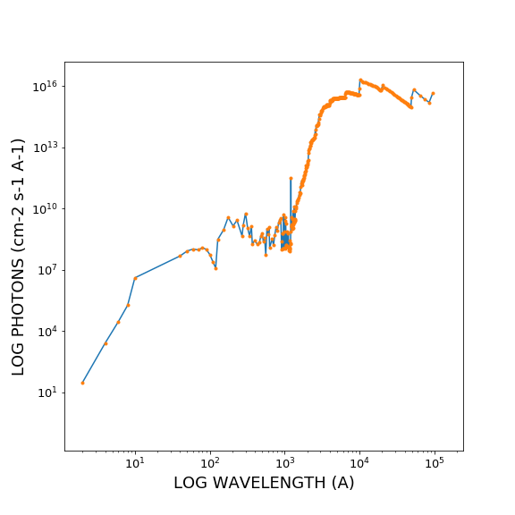
Reproduction of solar flux
Results
......
(A on all the diagrams = Angstrom = Å)

Slide 4
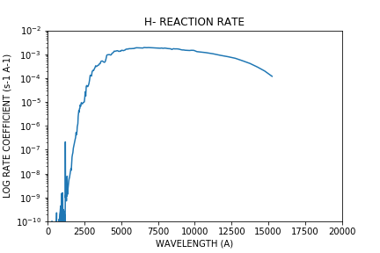
Reaction Rate Coefficient of H-
At 1 AU,
Coefficient = 14.1556 s^-1

Slide 5
Cl- and other elements
Chemical | C- | O- | F- | Si- | S- | Cl- | Br- | I-
Reaction rate coef at 1 AU (s^-1) | 3.394 | 1.768 | 0.06918 | 8.047 | 1.556 | 0.1163 | 0.2412 | 0.4808
Reaction rate coef at Enceladus (s^-1) | 0.04121 | 0.02147 | 0.0008400 | 0.09772 | 0.01890 | 0.001412 | 0.002928 | 0.005838
Half life at Enceladus (s) | 24.26 | 46.57 | 1190 | 10.23 | 52.91 | 708.0 | 341.4 | 171.3

Slide 6
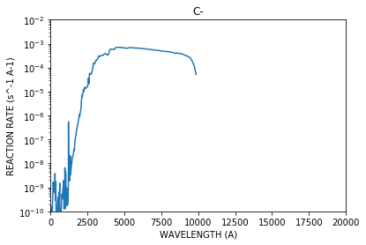
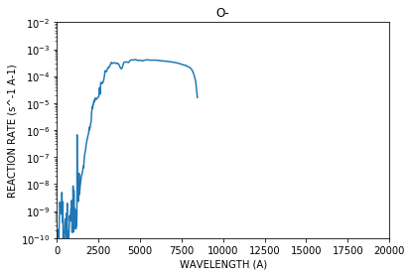
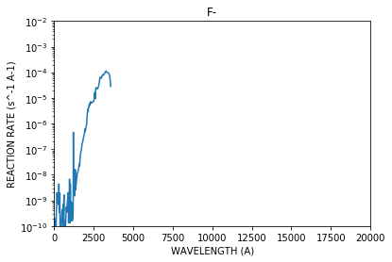
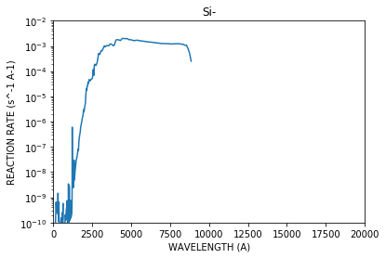

Slide 7
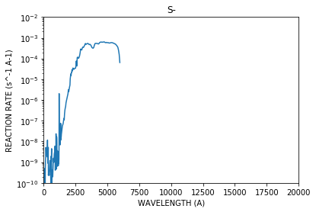
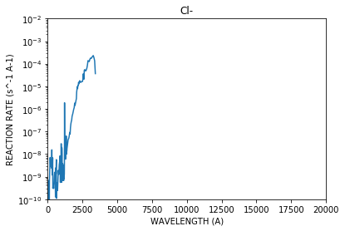

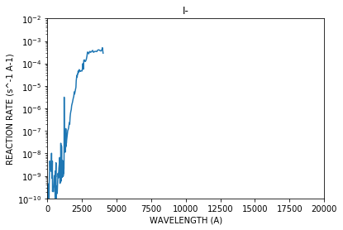

Slide 8
2nd Week (5.17-24)
Aim:
Half life against distance (AU)
Cross section of OH-, H2O-, H3O- if they exist
Comparison of results and theory

Slide 9
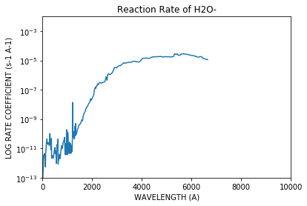
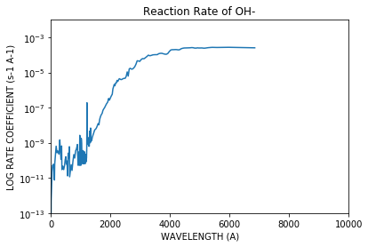
Reaction rate coefficient of OH-, H2O-
Results
The total reaction rate coefficient of H2O- is :
0.060445 s^-1
The total reaction rate coefficient of OH- is :
0.856830 s^-1

Slide 10
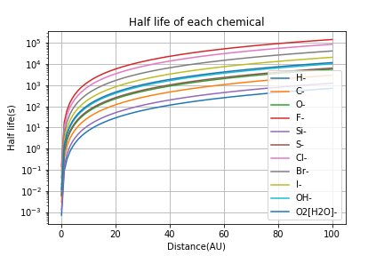
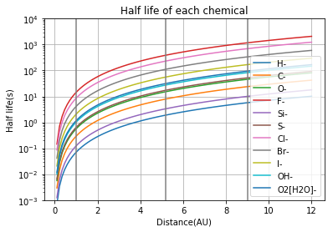
Half life against distance
First grey line = at Earth
Second grey line = at Jupiter
Third grey line = at Saturn

Slide 11
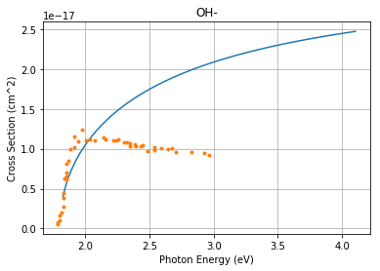
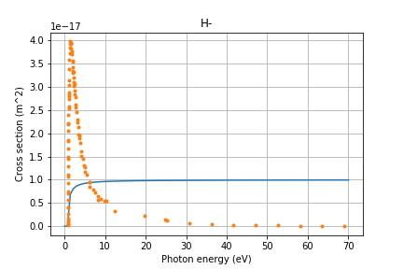
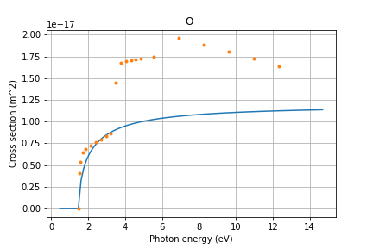
Comparison
We compared H-, O- and OH-

Slide 12
3rd Week (5.24-5.31)
Aim:
Loss rate from theory
Another theory - loss rate
Combine production rate coefficient and loss rate coefficient
In addition:
how far does the chemical go around Saturn

Slide 13
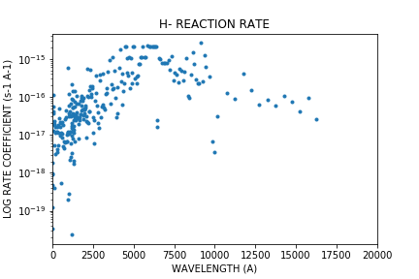
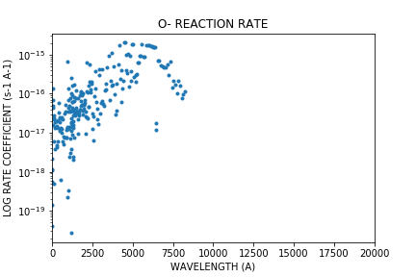
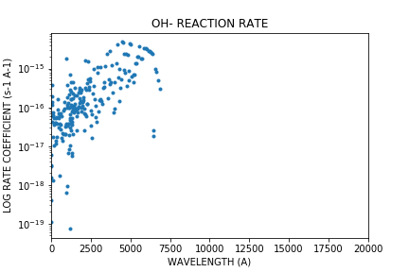
Reaction rate coefficient plot
According to equation E25.
Chemical | H- | O- | OH-
Model rate | 3.17 | 1.44 | 2.59
Actual rate | 14.2 | 1.77 | 0.86

Slide 14
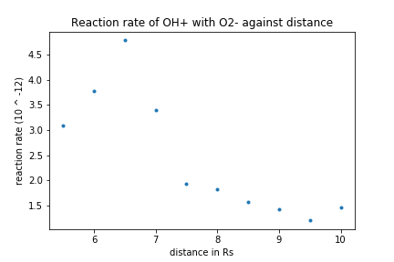
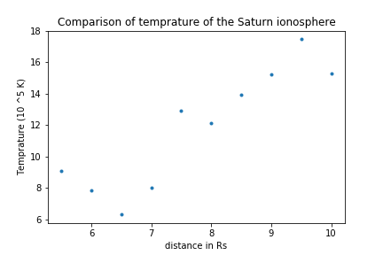
Recombination rate coefficient of negative with positive ions
Data for temperature: Wilson 2008 Fig.7
Calculation of rates: Equation (3), Miller 2012.
k is proportional to T^-1.1.

Slide 15
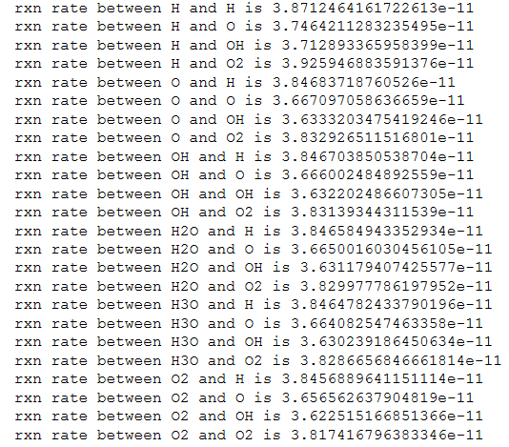
Recombination rate coefficients of negative with positive ions
Method:
For a diatomic anions, approximate monotomic anions

Slide 16
Average distance the chemicals can go around Saturn
if they are emitted from Enceladus
Chemical | H- | C- | O- | F- | Si- | S-
Distance (km) | 2300 | 9592 | 18410 | 471000 | 4050 | 20900
Angle extended (degree) | 0.554 | 2.31 | 43 | 113 | 0.974 | 5.04
Chemical | Cl- | Br- | I- | OH- | H2O- | /
Distance (km) | 280000 | 135000 | 67700 | 38000 | 539000 | /
Angle extended (degree) | 67.4 | 32.5 | 16.3 | 9.15 | 130
R = distance from Saturn to Enceladus
Assumed they all have the same angular speed as Saturn

Slide 17
4th Week (5.31-6.7)
Aim:
Reaction coefficient of collision of electron & neutral atoms：
e + H2O, e + O2

Slide 18
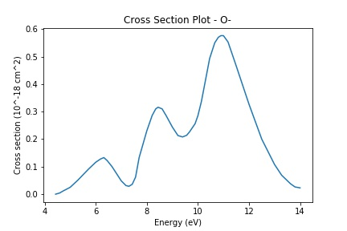
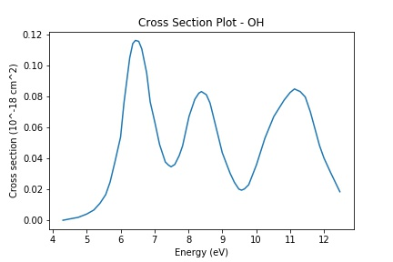
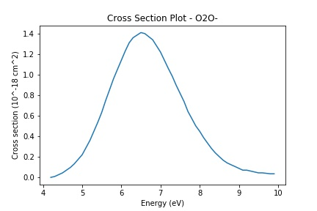
Cross section plot
Cross section for inelastic collision for each chemical

Slide 19
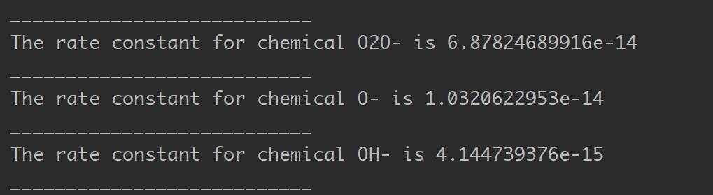
Collision rate coefficient
Formula used: on the right
<ve> = mean electron velocity (calculated from T)
sigma = cross section for inelastic scattering
f(v) = Boltzman distribution function

Slide 20
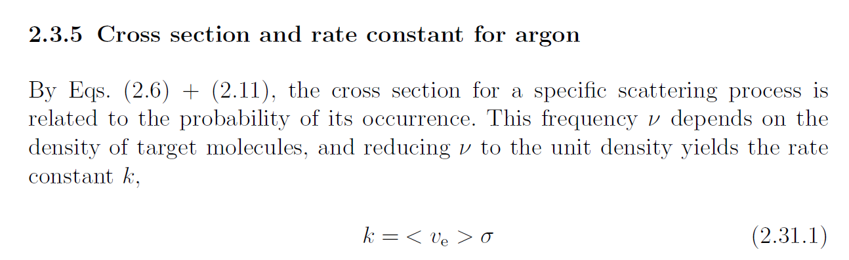
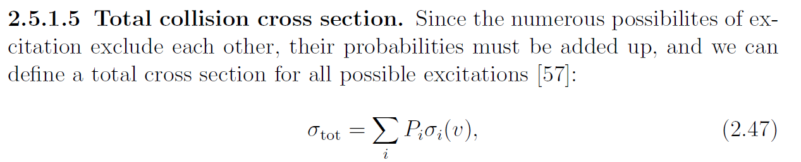
(Collisions and cross sections, Low Pressure Plasma and Microstructuring Technology. Franz, G)

Slide 21
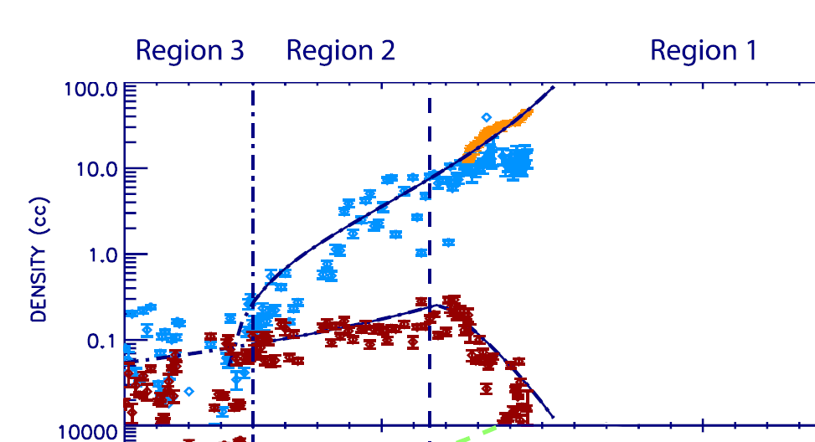
Rate analysis for water molecules
Electron density ~100/cc
(MultiInstrument Analysis Of Electron Populations In Saturns Magnetosphere, 2008)

